Slide 1
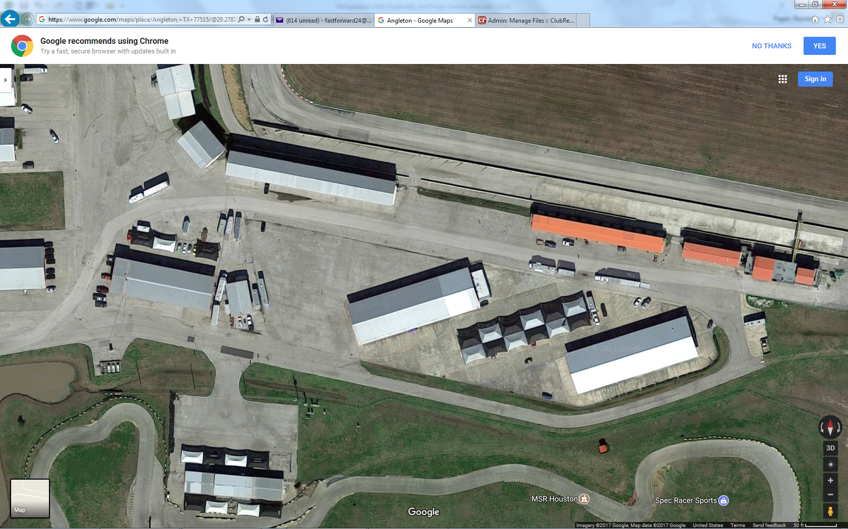
MSR-Houston CCW Layout
Trailer and track parking
Track exit to paddock
Track cars parking (green areas)
Control Tower
Grid
Instructors
Track entrance
Awnings
Entrance/Exit
1 → 24
Break Room Classroom
Gas
Pumps
Bathrooms
MSR Karting

